Slide 1
MAUVE: Measuring the Gap Between Neural Text and Human Text using Divergence Frontiers
Authors: Krishna Pillutla, Swabha Swayamdipta, Rowan Zellers, John Thickstun,
Sean Welleck, Yejin Choi, Zaid Harchaoui
Presenter: Kailin Liu
May 18th, 2022

Slide 2

Agenda
Introduction
Related Work
MAUVE
Experiments
Conclusion

Slide 3
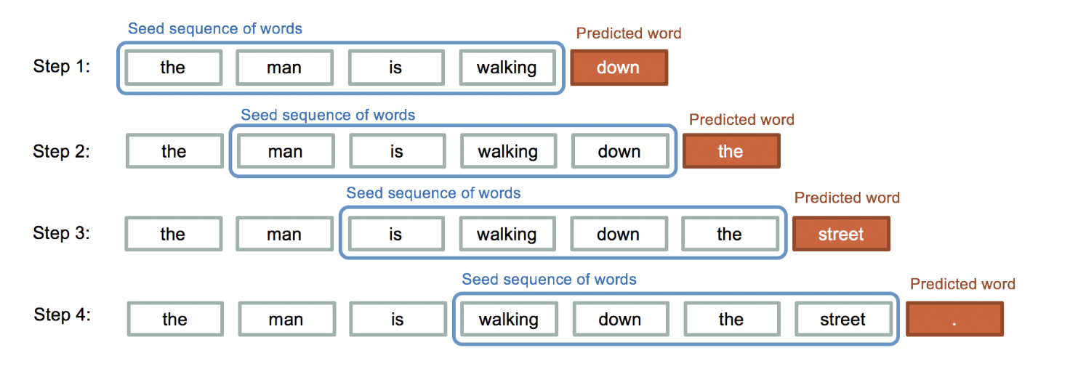
Introduction
MAUVE: a metrics to evaluate how close a generation model’s distribution is to that of human-written text

Slide 4
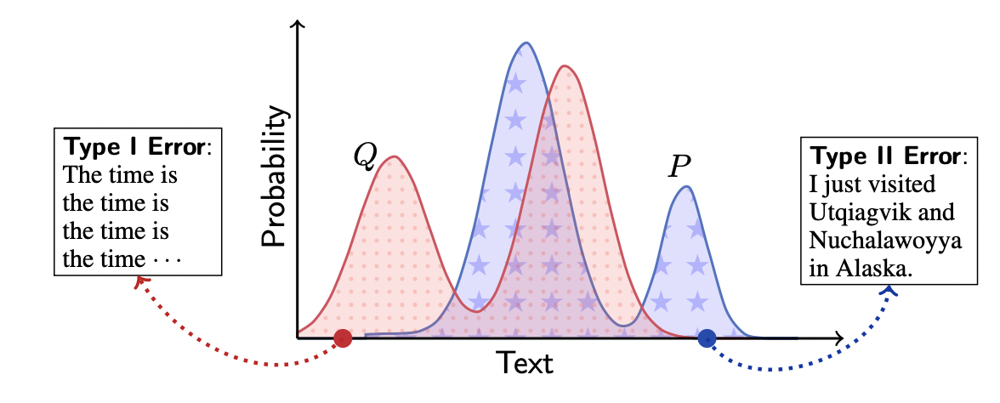
Introduction
Need to consider two types of errors:
Type One Error: where the model assigns high probability to sequences which do not resemble human-written text
Type Two Error: where the model distribution does not cover the human distribution

Slide 5
Related Work
Reference-based measures evaluate generated text with respect to a small set of reference text samples, rather than comparing full sequence distributions.
Statistics-based measures compare the model distribution Q with respect to the human distribution P on the basis of some statistic T(P) and T(Q).
Language modeling metrics calculate how (un)likely human text x ~ P is under the model distribution Q, for instance, using the probability Q(x).

Slide 6
Related Work: Drawbacks
Reference-based measures: not suitable for open-ended generation where there can be different choices of continuations, but more useful for generation tasks such as translation and summarization which have certain correct output.
Statistics-based measures: cannot trade-off the Type I and Type II errors
Language modeling metrics: cannot account for how likely the model text is under the human distribution P

Slide 7
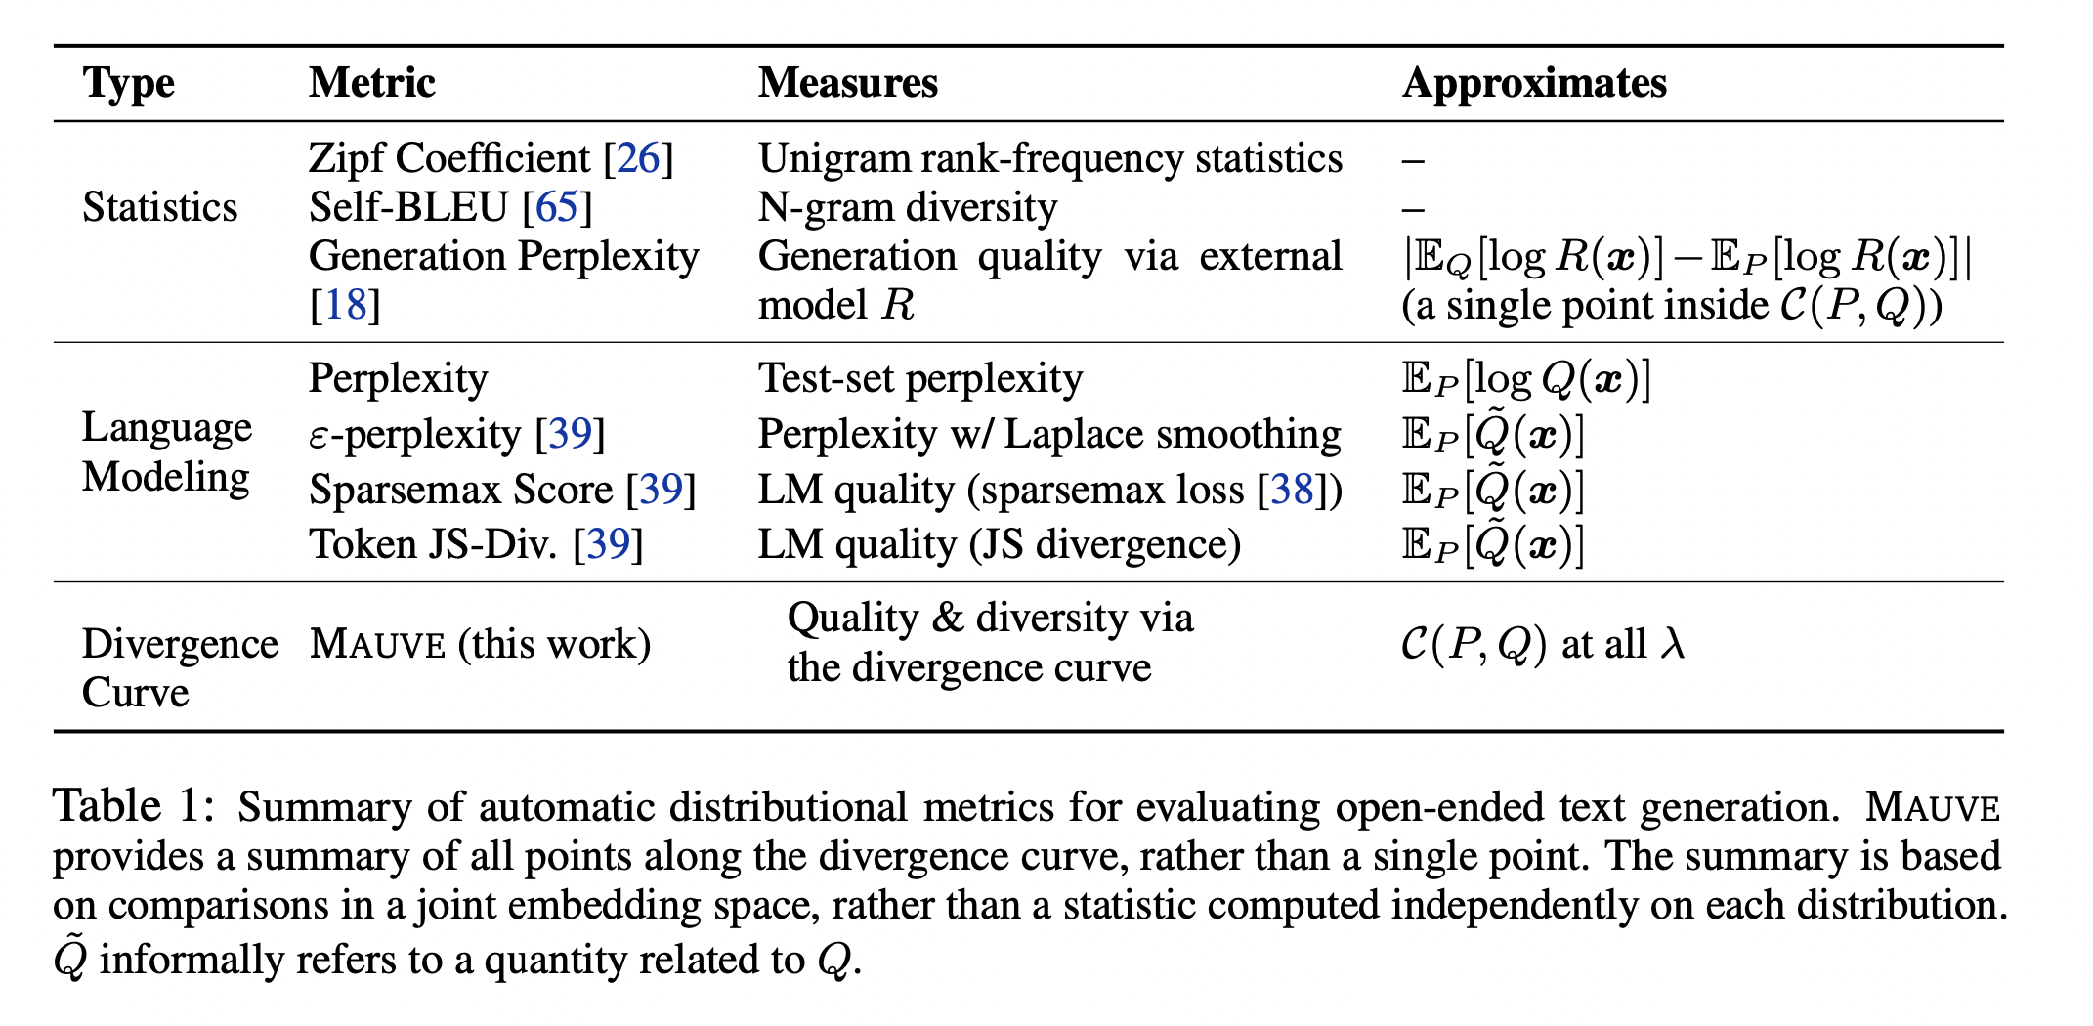
Related Work

Slide 8
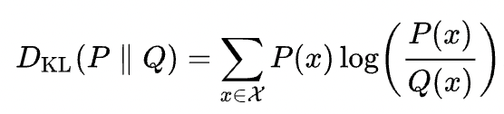
MAUVE: Quantifying Errors
We formalize the Type I and II errors with the Kullback-Leibler (KL) divergences KL(Q|P) and KL(P|Q), respectively.
KL(Q|P) quantifies the Type I error.
KL(P|Q) quantifies the Type II error.
However, if the supports of P and Q are not identical, one or both of the KL divergences would be infinite.

Slide 9

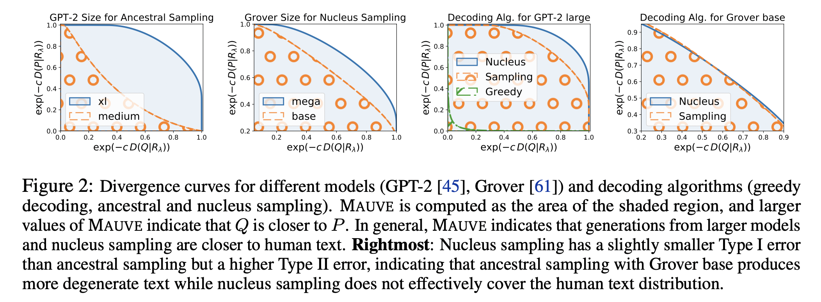
MAUVE: Divergence Curve

Slide 10
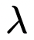

MAUVE: Connections to Common Divergences
KL(Q|P) can be obtained from the first coordinate of the curve C(P,Q) as
approaches 1.
KL(P|Q) can be obtained from the second coordinate of the curve C(P,Q)
as approaches 0.
Jensen-Shannon (JS) divergence can be obtained from = ½.

Slide 11
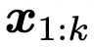
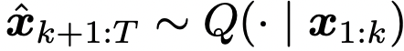
Experiments: Set-ups
Tasks:
given a context ,the task is to generate a continuation , forming a completion.
in three domains: web text, news and stories
Models:
GPT-2 as the language model Pˆ(·)
GPT-2 Large as the embedding model M(·)
Decoding Algorithms:
ancestral sampling which samples directly from the language model’s per-step distributions
greedy decoding which selects the most likely next token
nucleus sampling which samples from top-p truncated per-step distributions

Slide 12
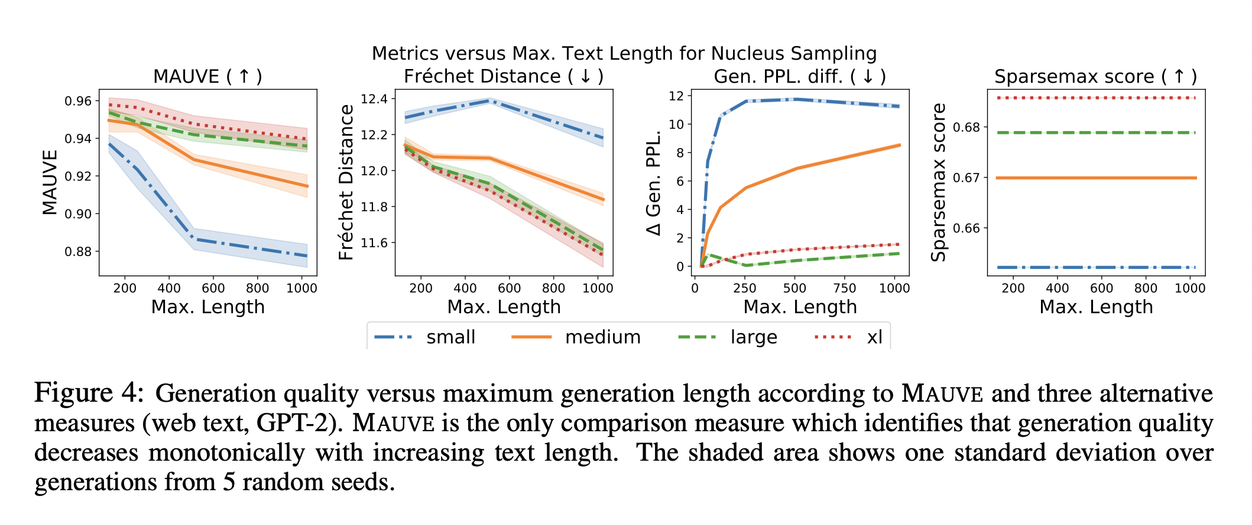
Experiments: How to Quantify Known Properties
MAUVE shows a decrease in quality (lower MAUVE) as generation length grows, with the trend consistent across model sizes.

Slide 13
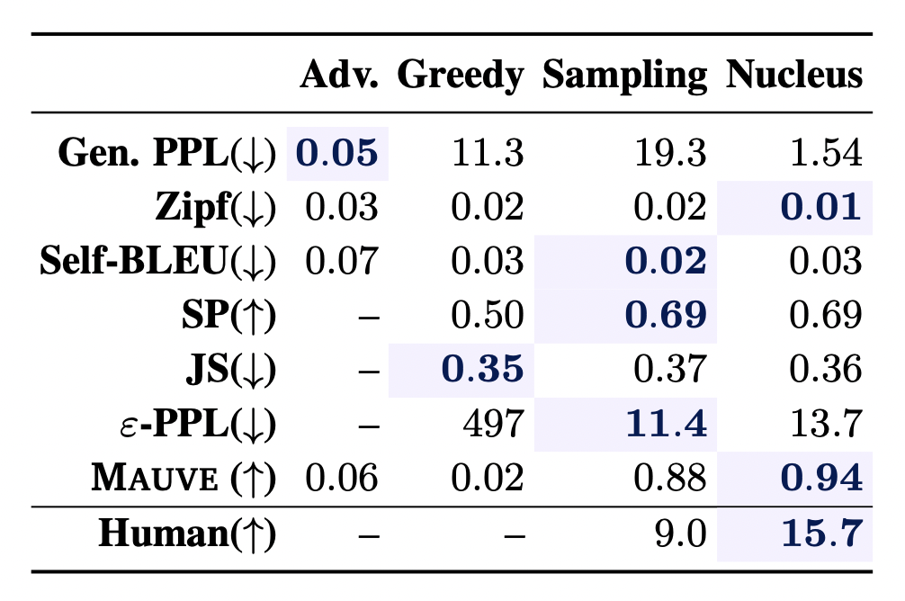
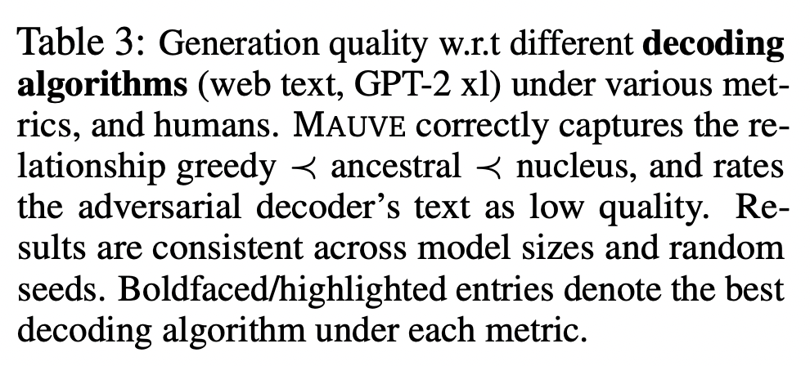
Experiments: How to Quantify Known Properties
MAUVE correctly identifies the expected quality relationship, assigning the lowest quality to greedy decoding (.016) followed by ancestral sampling (.882), and the highest quality to nucleus sampling (.940).

Slide 14
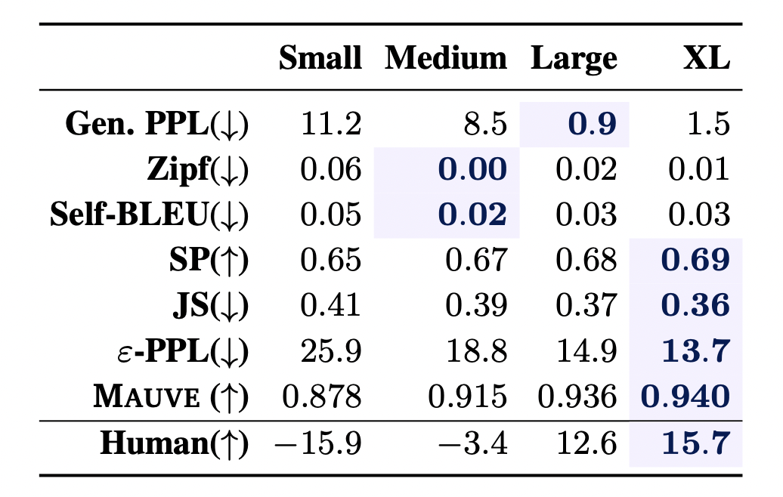
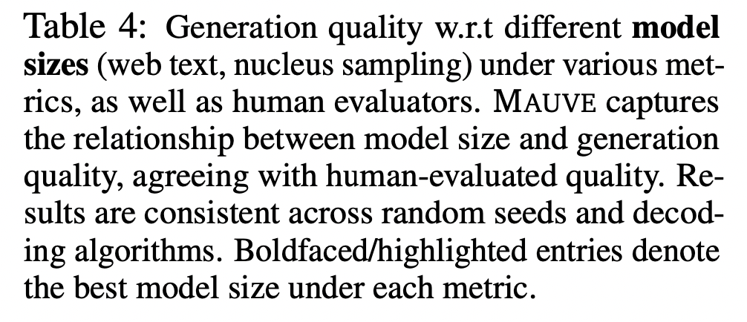
Experiments: How to Quantify Known Properties
MAUVE increases as model size increases, agreeing with the human quality measure and the expectation that larger models should have higher quality generations.

Slide 15
Experiments: Robustness
MAUVE works with alternative embedding models.
MAUVE with features from RoBERTa- large gives qualitatively similar trends across model size and decoding as MAUVE with features from GPT-2 large.
MAUVE is robust to quantization.
Comparing k-Means, Deep Residual Mixture Models (DRMM), and Lattice Quantization
MAUVE is robust to hyperparameter settings.
Adjusting the scaling parameter c does not affect the relative order of the divergence curve

Slide 16
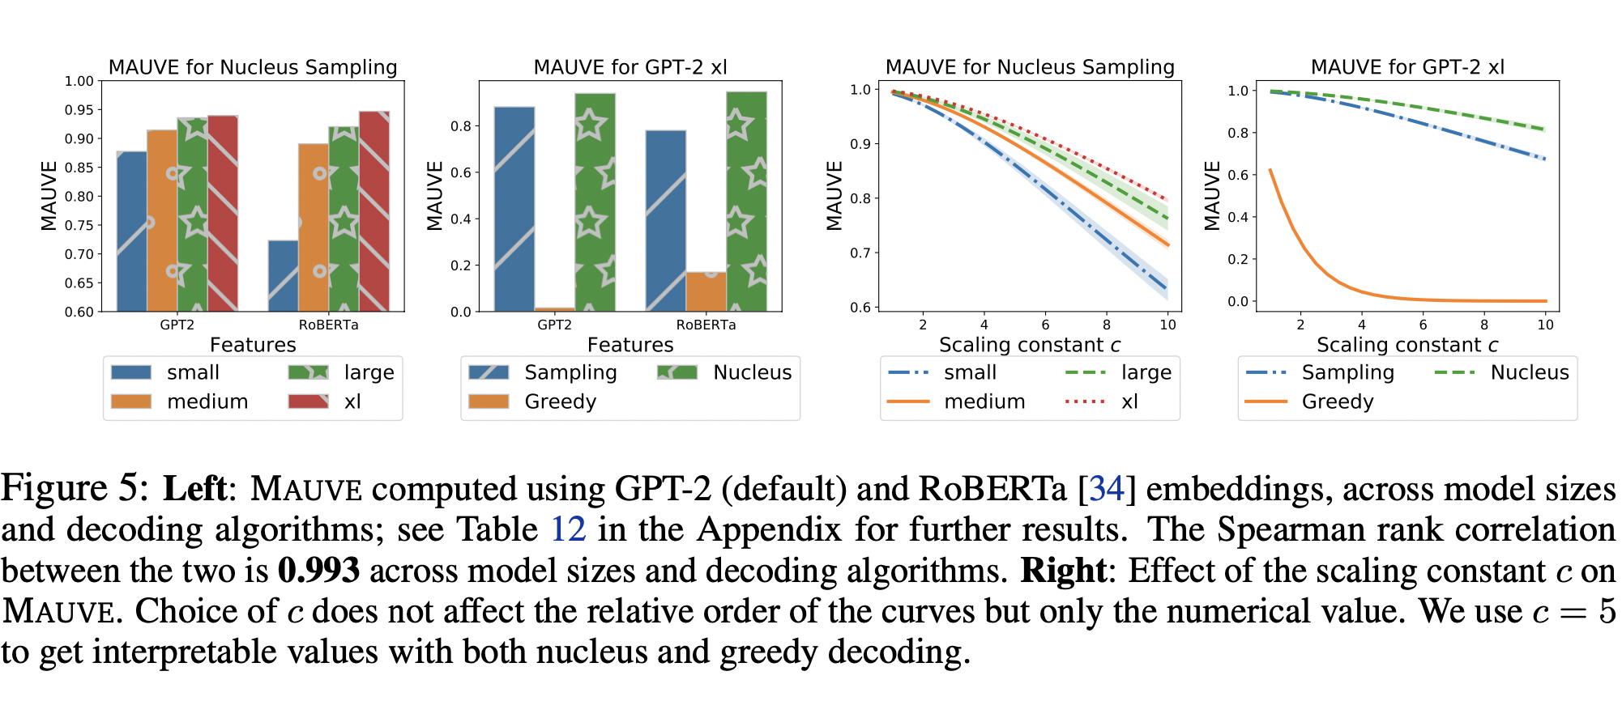
Experiments: Robustness

Slide 17
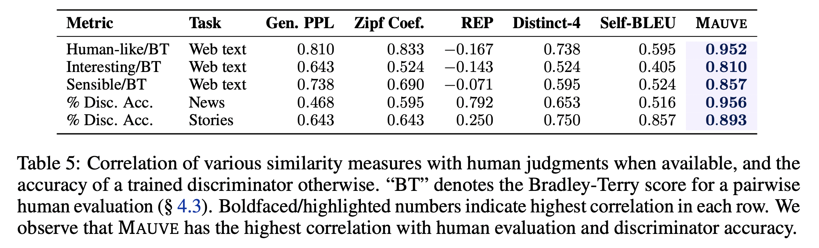
Experiments: Human Judgements
MAUVE correlates highly with human judgments of how human-like (0.952), interesting (0.810), and sensible (0.857) the machine text is.
MAUVE correlates the highest with the discrimination accuracy (0.96 for news and 0.89 for stories) among all comparison measures.

Slide 18
Conclusion
We introduce MAUVE, a comparison measure between neural text and human text.
We empirically show that MAUVE is able to quantify known properties of generated text with respect to text length, model size, and decoding more correctly and with fewer restrictions than existing distributional evaluation metrics.
We find that MAUVE can be highly robust to the choice of quantization, embeddings, and scaling.
We find through a human evaluation that MAUVE better correlates with human quality judgements of text.

Slide 19

Thanks for listening!

